Slide 1
HanaBudget
An Expense Tracker App

Slide 2
The Team!
Mark Denina
Alexis Cruz Aboytes
@mdenina1
@ChicoQuemador1
Link to repository:
https://github.com/ChicoQuemador1/HanaBudget

Slide 3
What’s the Pitch?
Meet HanaBudget: the friendly and simple expense tracker app. Built with Flutter for a smooth ride on any mobile device and utilizing Atlas MongoDB for local database management, it ensures your financial data is always at your fingertips, secure, and up-to-date. Whether you’re watching your spending, setting up budget goals, or just curious where your money goes, HanaBudget has your back. It’s your go-to finance buddy in this busy, connected world, helping you stay on top of your money game without breaking a sweat.

Slide 4
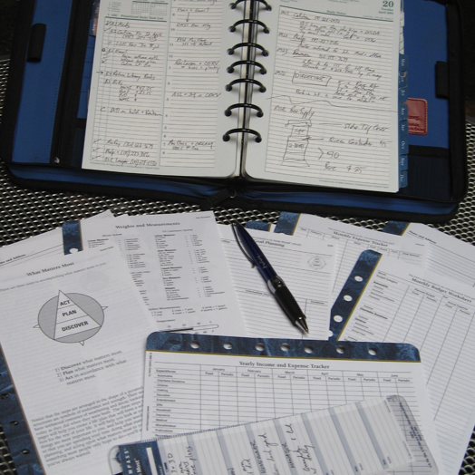
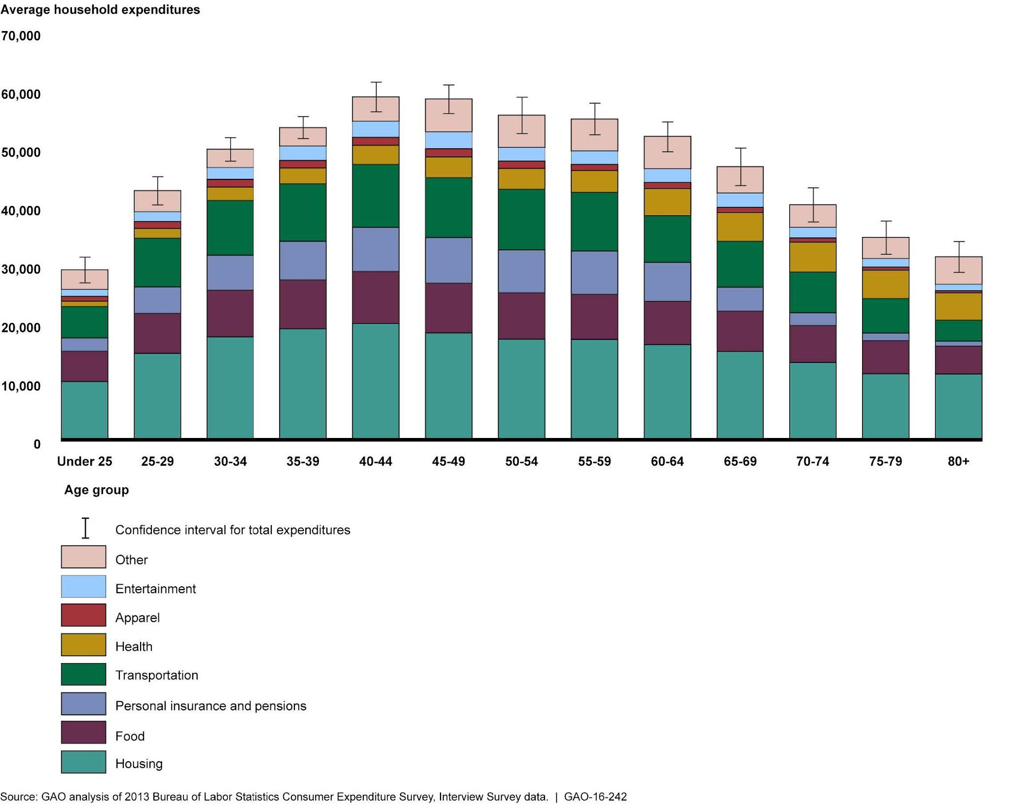
Problems with Trackers Today:
Complex
Limited Customization
Difficult to analyze
Our Solution:
Made simpler
Easy to read/access
Customizable to any user

Slide 5
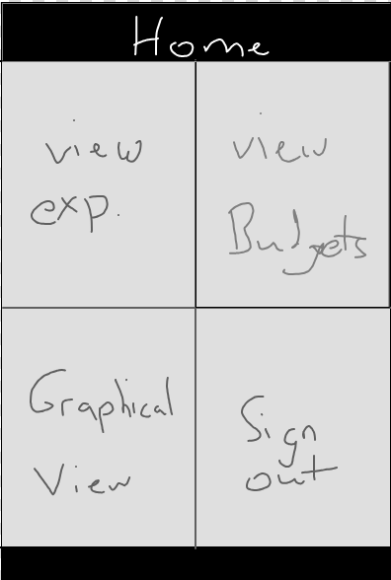
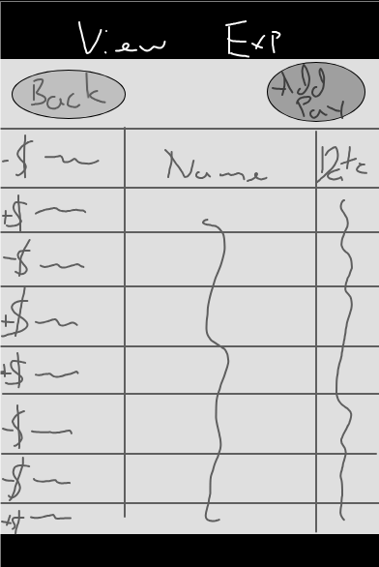
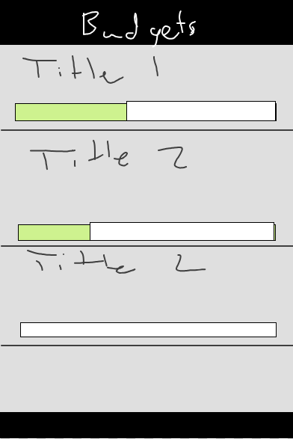
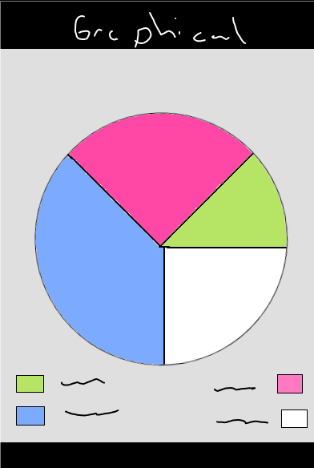
Layouts

Slide 6
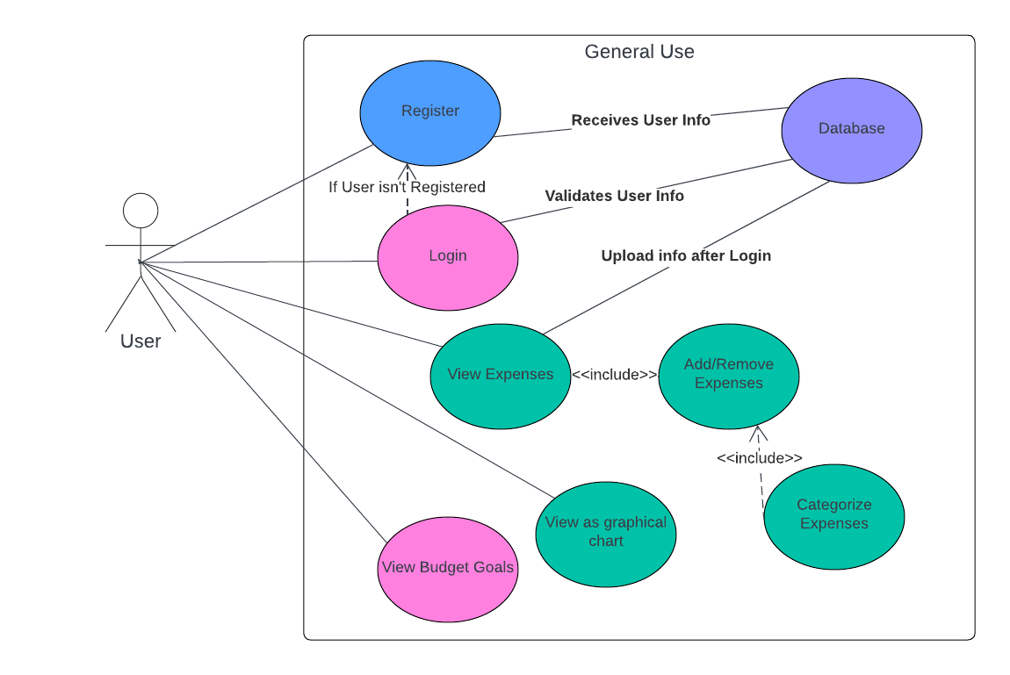
01 Home Screen
User Experience

Slide 7
02 View Expenses
User Experience

Slide 8
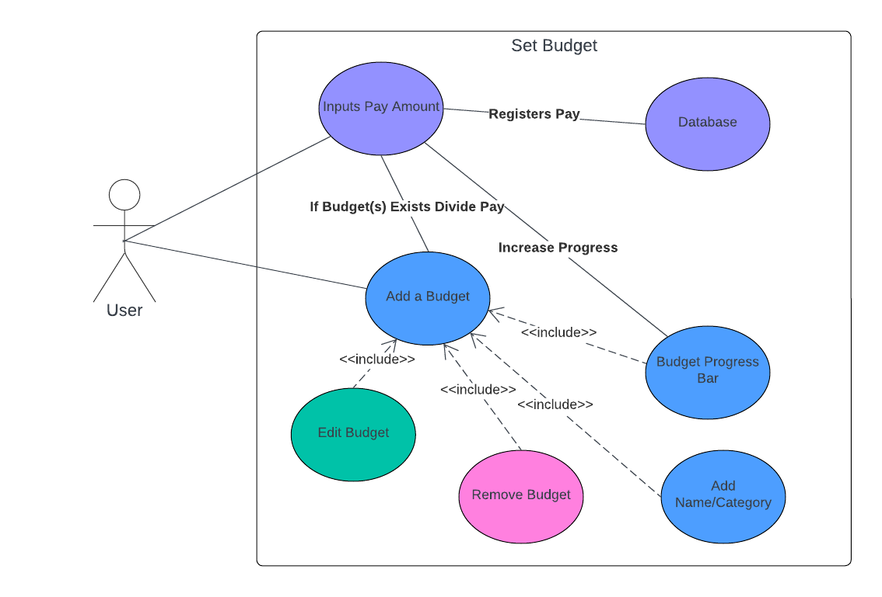
03 Budget
User Experience

Slide 9
04 Graphical View
User Experience

Slide 10
Functionality
Screen to Screen

Slide 11
01 Iterative Design

Slide 12
02 Iterative Design

Slide 13
Iterative Design
Feedback Loops
Improvements

